Slide 1


YouTube Video Popularity Prediction
IRONHACK BOOTCAMP FINAL PROJECT
Pooja Gadham Setty

Slide 2

MOTIVATION
To help content creators to tailor their videos to audience preferences and maximize user engangement

Slide 3
USE CASES
Predict video Popularity without interactions
Predict video Popularity with interactions

Slide 4
STEPS FOR SUCCESS
YOUTUBE API + KAGGLE DATA
DATA CLEANING
EXTRACING TEXT FEATURES (NLP)
DATA ANALYSIS
MODELING
FINE TUNING
https://www.kaggle.com/datasets/asaniczka/trending-youtube-videos-113-countries

Slide 5
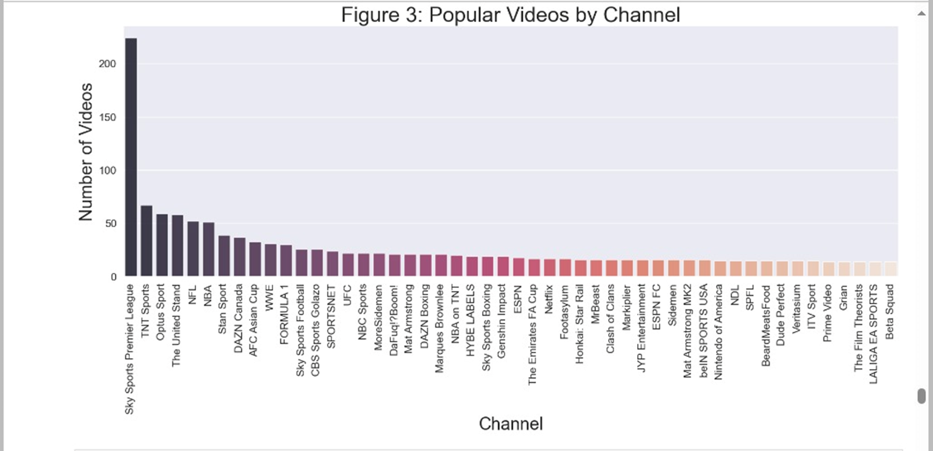
TOP 50 POPULAR VIDEO CHANNELS IN YOUTUBE

Slide 6
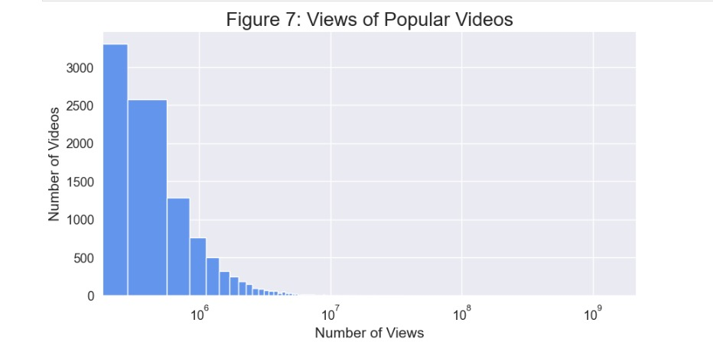
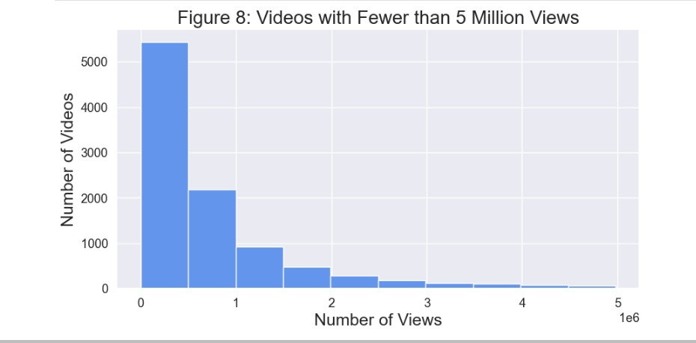
VIEWS OF POPULAR VIDEOS

Slide 7
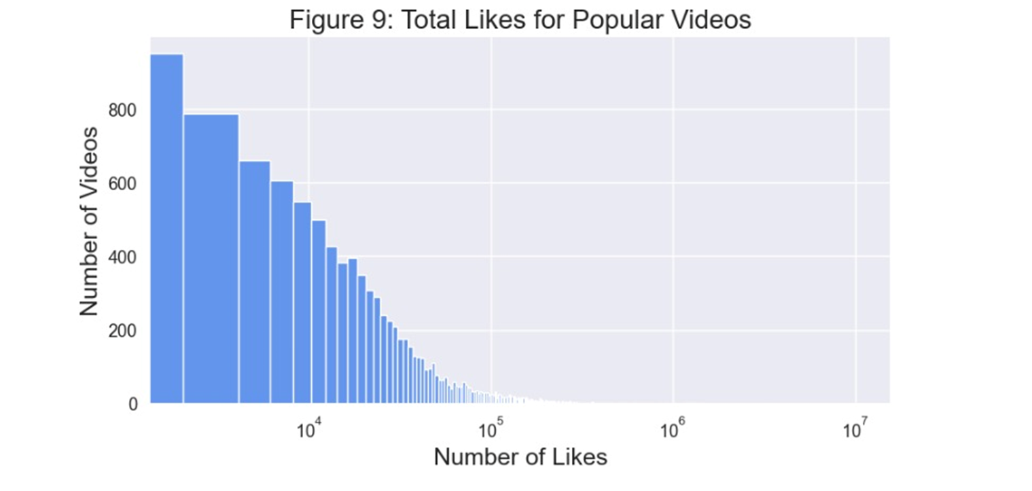
LIKES FOR POPULAR VIDEOS

Slide 8
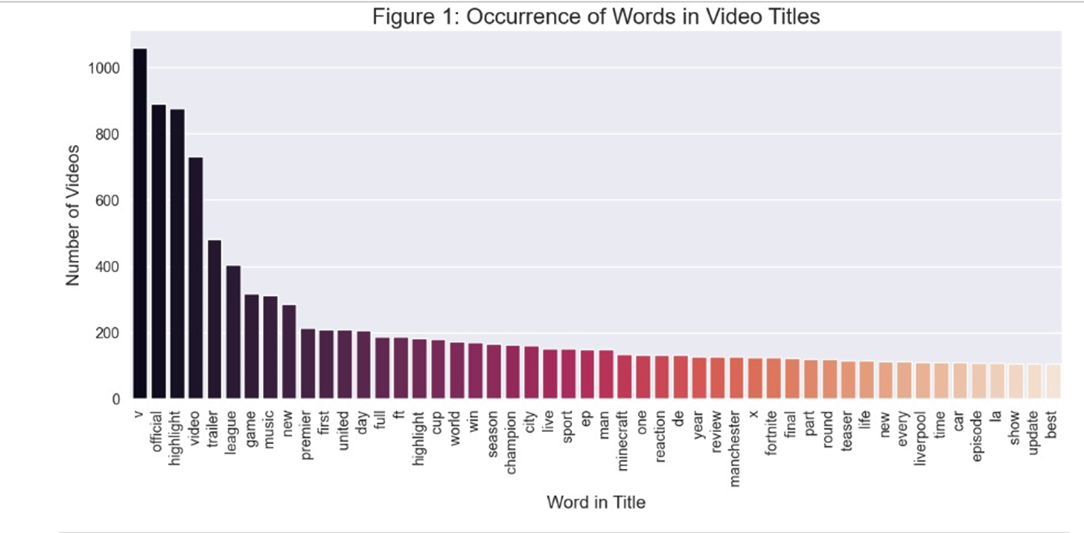
FREQUENT WORDS IN VIDEO TITILE

Slide 9
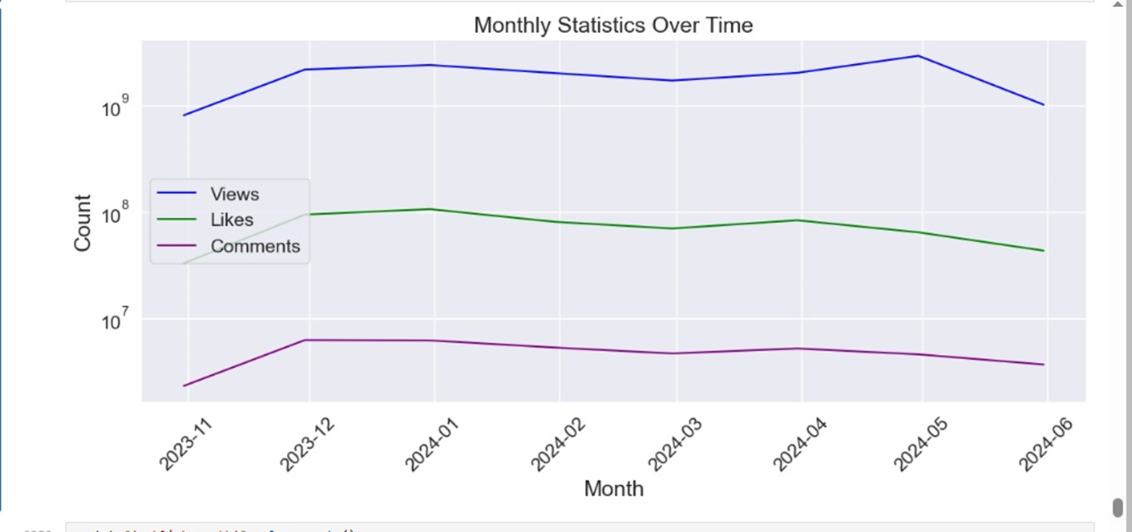
MONTHLY STATISTICS OVER TIME

Slide 10
PREDICTIVE MODELLING RESULTS
Use Case 1:
REGRESSION MODEL | RMSE | R2 SCORE
LINEAR | 1.0509224842734217 | 0.274605139481628
RIDGE | 0.7687917712336275 | 0.6118044442125419
KNN | 1.0233993104363792 | 0.3121031088791024
SVM | 0.842527604835509 | 0.533768744185466
XGBoost | 0.8396959667262528 | 0.5368973768075809
Ridge Regression achieved the best performance with the lowest RMSE and highest R² score, followed closely by XGBoost and Support Vector Machine.

Slide 11
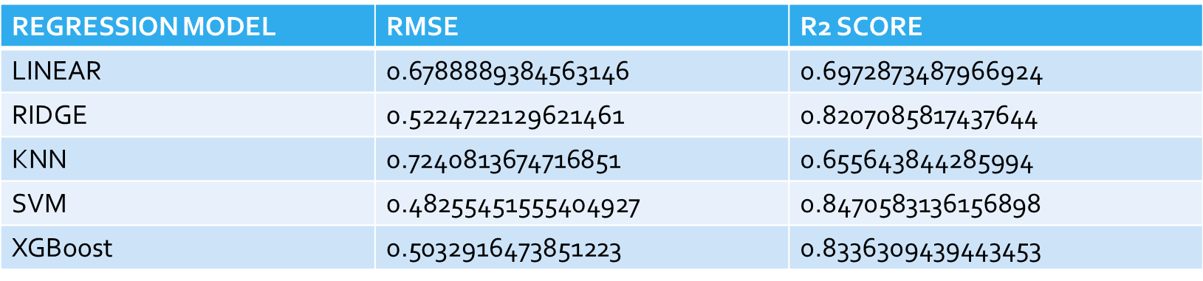
PREDICTIVE MODELLING RESULTS
Use Case 2 :
Support Vector Machine achieved the best performance with the lowest MSE and highest R² score, followed closely by XGBoost and Ridge Regression..

Slide 12

FUTURE SCOPE
Scale up the data
Various Text Extractions Techniques (word2vec)
Perform Deep Learning models
Video movement and Voice recognition

Slide 13


